Slide 1

Artificial Intelligence in Finance at Hong Kong University of Science and Technology
Notes:
Ask Prof. Yao:
End class at 10pm?
Is it okay for 2-page paper from each student, students get credit as long as they write the paper and we do not have to read them

Slide 2
Course Schedule
Session | Date | Topic | Application & Case Study | In-Class Activity
1 | Feb 1 | History and Overview of Artificial Intelligence | Google Experiments: Draw! | Kahoot
2 | Feb 15 | Supervised & Unsupervised Learning | Google Experiments: Vision Sensing Case study: HireVue (Video Analytics for Recruitment) | Class survey and group formation Kahoot
3 | Feb 22 | Classification vs. Regression Model Assessment and Selection | Chatbots Case study: WorkFusion (Robotic Process Automation) | Kahoot
4 | Mar 1 | Decision Trees and Random Forests Support Vector Machines | Credit analysis Case study: Clover (Temporal Unfolding) | Kahoot
5 | Mar 8 | Neural Network Deep Learning Introduction | TensorFlow Neural Network Playground | Kahoot
6 | Mar 15 | Practitioners’ Perspectives Independent Consultation for Projects | Slido Q&A | Sharing from researchers and industry professionals
7 | Mar 22 | Recurrent Neural Network (RNN) | Natural language processing Case study: Deep Instinct (Cybersecurity) Speaker: Mr. Jeffrey Hui | Word2Vec Kahoot
8 | Mar 29 | Convolutional Neural Network (CNN) | Google Image Recognition Case study: SenseTime (Computer Vision) | 3D Visualization of CNN Kahoot
9 | Apr 12 | Reinforcement Learning | Case study: Osaro (Robotics), Ascent (Autonomous Driving) | Kahoot
10 | Apr 26 | Midterm Exam Independent Consultation for Projects |  | TBA
11 | May 3 | Recent Advances & Applications of AI Catalysts & Enablers of AI | Recap of concepts Case studies: Airobotics (Drones), Cornami (AI Chip) | Kahoot
12 | May 10 | Frontiers of AI Challenges in AI Commercialization | Recap of concepts Case studies: Prophesee (Computer Vision), Prowler (AGI) Speaker: Mr. Christopher Lee | Review of Neural Ordinary Differential Equations (NIPS 2018)
13 | May 17 | Synthesis & Outlook |  | Final presentations (details TBD)
Note: Details may change depending on class progress, development of relevant technologies, as well as information and feedback from students’ surveys.

Slide 4
Beyond the Classroom
Session | Date | Topic
3 | Feb 22 | HireVue: Recruiting & AI
4 | Mar 1 | Company Research: Bloomberg, McKinsey Insights, Zero2IPO
5 | Mar 8 | PowerPoint Creation
6 | Mar 15 | CV Writing & Interview Preparation
7 | Mar 22 | Certifications (CFA, CPA, GMAT…)
Session | Date | Topic
8 | Mar 29 | LinkedIn & Networking
9 | Apr 12 | Industry Primer: Investment Banking
10 | Apr 26 | Industry Primer: Management Consulting
11 | May 3 | Industry Primer: FinTech & VC/PE
12 | May 10 | Presentation Skills

Slide 5
www.slido.com
#POLL

Slide 6








Robotic Process Automation
机器人与工序自动化
Full-stack AI-enabled Robotic Process Automation (RPA) solution suite for business-critical tasks spanning multiple applications and data silos
Quantum Computing
量子计算
Solution provider and platform developer for quantum and classical computing for predictive analytics, forecasting, and optimization
Computer Vision
计算机视觉
Developer of deep learning technology-based computer vision solutions aimed at a broad range of consumer and enterprise applications
Knowledge Graph
知识图表
Dynamically evolving knowledge graphs that provides inference strength across concepts, events and themes derived from a wide variety of information services
Real-Time Robotics Automation
实时机器人自动化
Deep reinforcement learning-based AI software platform that enables enhanced perception, reaction and control in real-time robotics environments
AI Chips
人工智能芯片
Deep reinforcement learning-based AI software platform that enables enhanced perception, reaction and control in real-time robotics environments
Cybersecurity
网络安全
Advanced deep learning technology-based cybersecurity products and solutions for threat detection and prevention
Music Augmentation
音乐强化
Developer of a music augmentation technology that transforms linear music to dynamically personalized music for consumers, ad-agencies, music labels, and producers
Contents are based on information from sources believed to be reliable, but accuracy and completeness cannot be guaranteed. Nothing herein should be construed as any past, current or future recommendation to buy or sell any security or an offer to sell, or a solicitation of an offer to buy any security. This material does not purport to contain all of the information that a prospective investor may wish to consider and is not to be relied upon as such or used in substitution for the exercise of independent judgment.

Slide 7



If you have sent me your CV, let’s talk during the break or after class
Key Responsibilities
Keen interest and experience in venture capital transactions and financial analysis
Familiar with transaction legal documents and investment structure
Understanding of the commercialization of technologies from an investor perspective
Conduct due diligence for potential investments in the AI space
Assist in the preparation of deal-related materials (e.g. data collection, industry research, comparable company and valuation analysis)
Position Requirements
Undergraduate or postgraduate students, preferably majoring in Finance, Investments, Legal Studies, and/or Business Analytics
Experience in using Bloomberg, S&P Capital IQ, Pitchbook, and Wind preferred
Exposure and understanding of the high-tech industry (especially AI/ML) a plus
Strong sense of responsibility and attention to details
Availability: Spring and Summer 2019
Number of Openings: 1-2
Renumeration: Market competitive
Office: Central • Hong Kong
Anthony Woo
CFA CAIA FRM
Associate Director
Alpha Intelligence Capital
aw@aicapital.ai

Slide 8
Course Objectives
Individual
Group
AI/ML Theories
Group Project
Venture Idea
Startup Pitch
AI/ML Techniques
Midterm Exam
AI/ML Article Writeups

Slide 9
Dear Professor Mathieson:
My name is Anthony Woo. I am currently a Master’s student at the Faculty of Education here at HKU, and one of the Honorary Career Advisors at CEDARS. Hope all is well.
I have started a career development company at HKU leveraging the use of technology in education to help augment career development and vocational training for university students and young professionals. The company seeks to adopt the latest ICT developments, such as big data analytics and adaptive learning mechanisms, in helping job seekers build a solid foundation for their future success.
By way of background, I have over eight years of work experience in finance at J.P. Morgan and Morgan Stanley. I completed my MBA at Harvard Business School, and graduated from U.C. Berkeley summa cum laude with a B.S. degree in Business.
I understand that you must be very busy. But do you have 15 mins to spare so I can learn from your advice and insights on this initiative? Thank you very much.
Sincerely,
Anthony Woo, CFA CAIA FRM
LinkedIn: www.linkedin.com/in/anthonywoo

Slide 11
www.slido.com
#UST

Slide 12

History of A.I.
Neural Ordinary Differential Equations
Deep Learning
“In the first wave of AI you had to be a programmer. In the second wave of AI you have to be a data scientist. The third wave of AI — the more moral you are, the better.”
Neural Network
Expert System
1956
1980
2000
2010
Source: Dr. Lee Kai-Fu • Sinovation Ventures and 2018 Conference on Neural Information Processing Systems

Slide 13

Credit: https://www.slideshare.net/bretmc/machine-learning-with-google-machine-learning-apis-puppy-or-muffin

Slide 14
A Tale of Two AI Camps
Property | Symbolic AI | Connectionist AI
Knowledge Acquisition | Theoretical knowledge insertion can be made in a simple and direct manner. It is sufficient to clarify, convert, and formalize the knowledge. | Theoretical knowledge may not useful in constructing neural networks, while examples are always required for knowledge acquisition.
Processing Mode | Processing is sequential. Answer and consultation times are long. | Neural networks consist of a set of units with information processing completed in a parallel fashion.
New Knowledge Insertion | Insertion of knowledge (rules) can be made very quickly once experts have already processed them. | Training process is often time-consuming as weights and biases are trained gradually.
Training | Training is not a basic process. Knowledge acquisition is done by explicitation, with potential bottleneck issues. | Training and generalization from examples are fundamental and integrate processes.
Results Explanation | Reasoning process allows for explanability. Knowledge is coded in a language close to natural language, and therefore easily interpretable. | Neural networks are “black” boxes, where knowledge is coded in weights and interconnections, with a lack of access to a form that is interpretable by humans.
Source: Souici-Meslati, Labiba & Sellami, Mokhtar. (2004). A hybrid approach for Arabic literal amounts recognition. The Arabian Journal for Science and Engineering. 29.

Slide 15
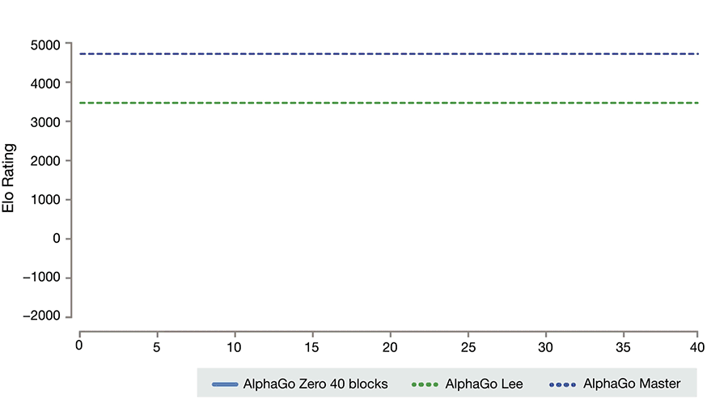

Slide 16
A.I. Landscape: China vs. U.S.
 | China | United States
Institutional Norm | Large volume of data via proprietary systems, yet to focus on building innovation capacity. China tends to be averse to adopting the standard metrics structures used by most multinationals. Chinese A.I. initiatives are good at developing facial recognition as well as tools for surveillance and tracking. | A.I. ecosystem with unified standards and cross-platform sharing. More conducive to developing international standards for what is acceptable for law enforcement use of big data and A.I., and how they will be held accountable for abuse. Developing A.I. tools for surveillance and tracking remains a sensitive topic in U.S.
Regulatory Environment | Tends to set regulations after product commercialization. Pursues a strategy of “military-civil fusion” in A.I., as China devises a range of policy mechanisms to incentivize industry cooperation. A looser approach to digital regulations means that companies have more freedom to experiment. | Tends to set regulations before product goes to market. The White House has so far been characterized as “missing-in-action” in terms of policymaking for A.I.
Industry Structure | 592 A.I. companies (23% of global). Came second in the total number of A.I. enterprises in the world in 2017, and contributed 48% of the world’s total A.I. startup funding. A.I. Potential Index = 17. | Ranked first with 1,078 A.I. firms (42% of global). Provided 38% of the funding for A.I. startups globally in 2017. A.I. Potential Index = 33.
Anthony Woo • Harvard Business School Asia-Pacific Research Center

Slide 17
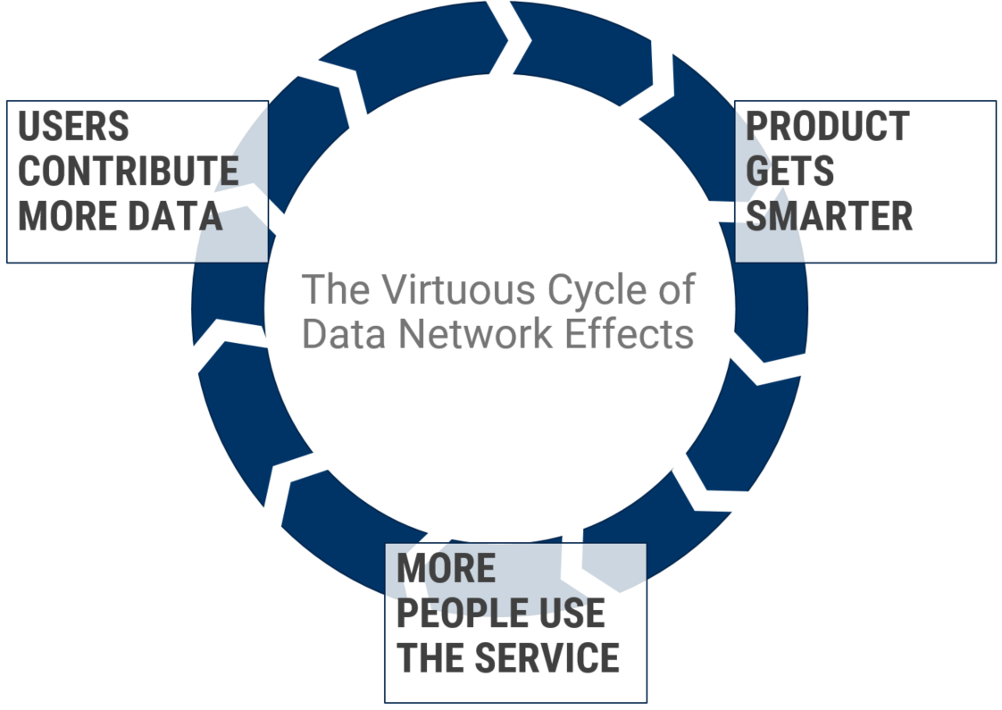

Slide 18
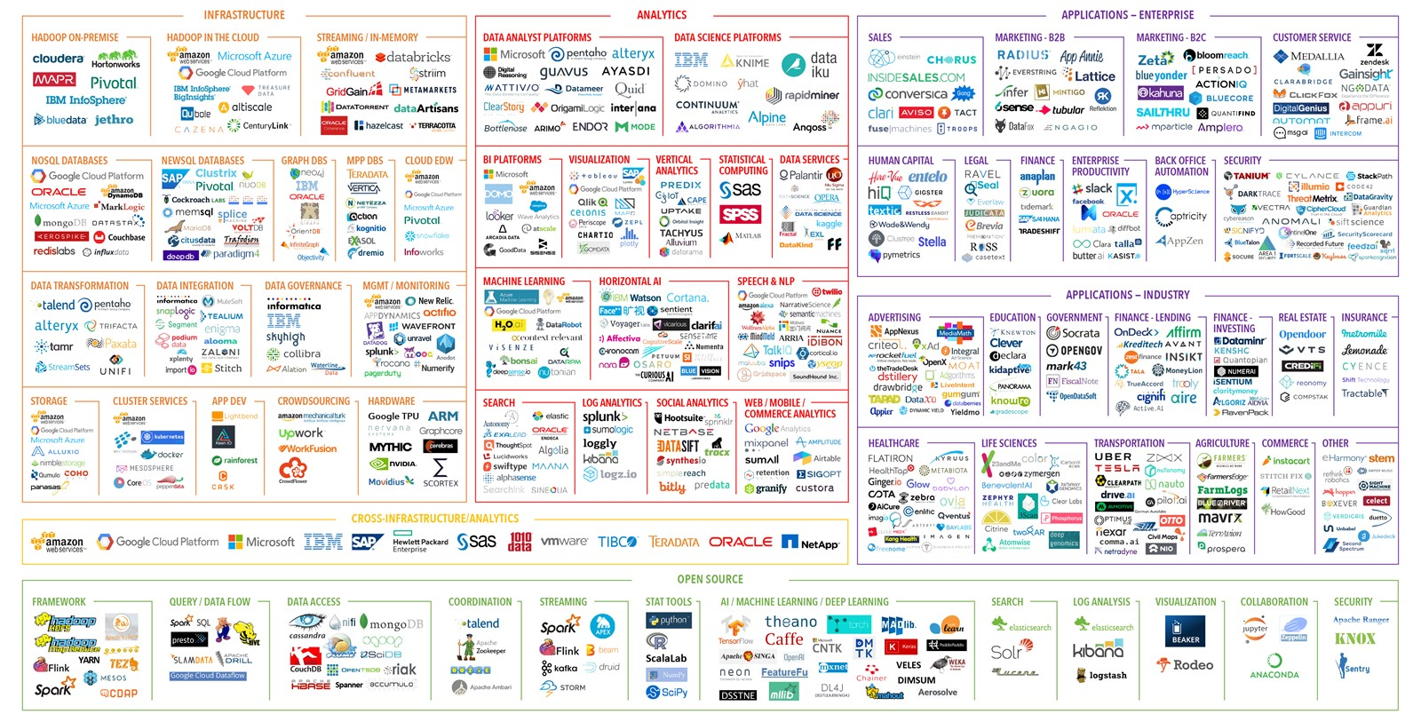

Slide 20
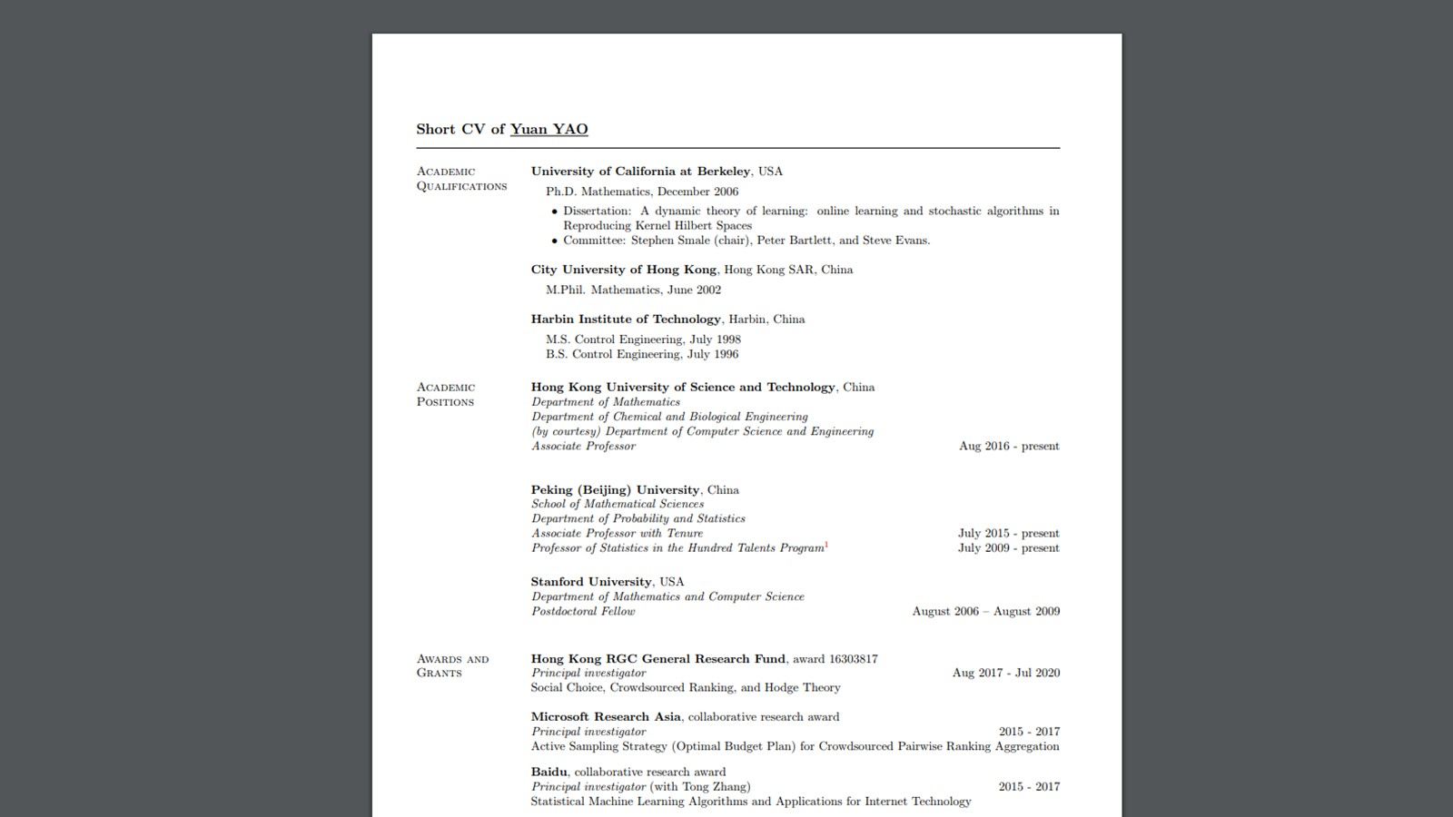

Slide 21

Interact
Encourage
https://kahoot.it/
Please wait for the Game Pin
Use your full name for attendance
Reward

Slide 22


www.slido.com
#UST
Source: https://debrief2learn.org/

Slide 23
https://goo.gl/KRoiJt

Slide 24
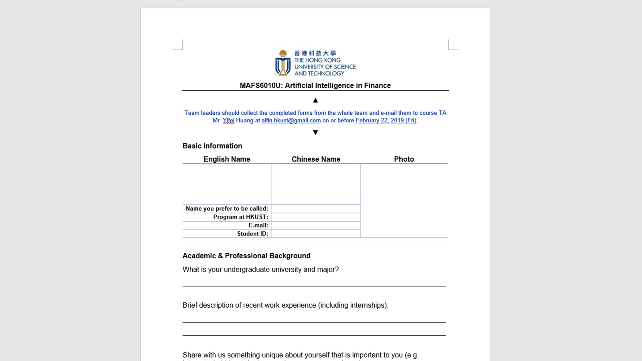

Slide 25
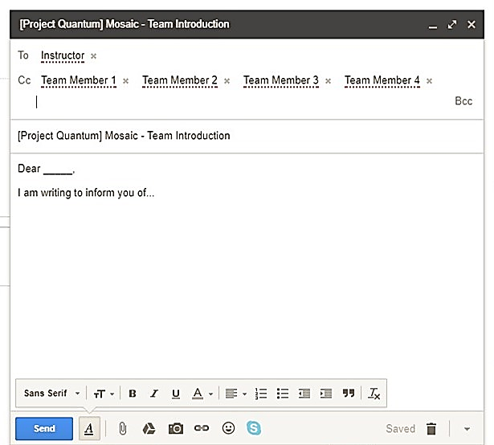
Codename
Teaching Assistant
Project Quantum
Project Redbook
Project Dragon
Project Oasis
Project Fire

Slide 26
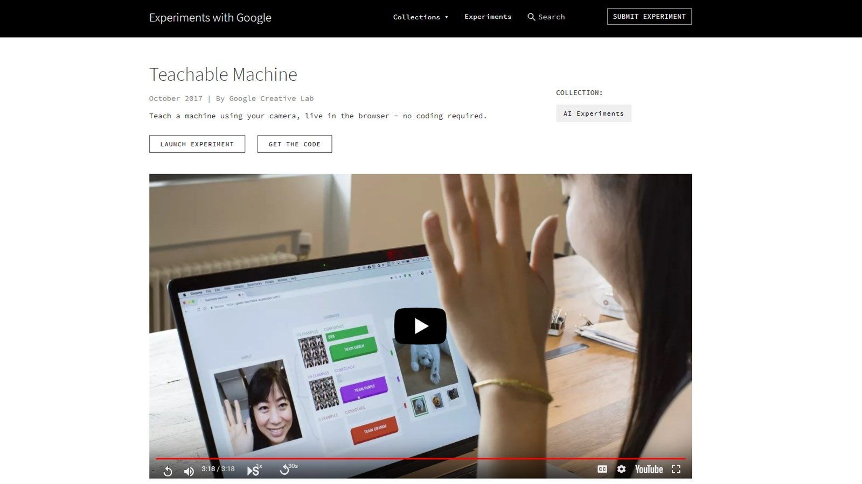

Slide 27
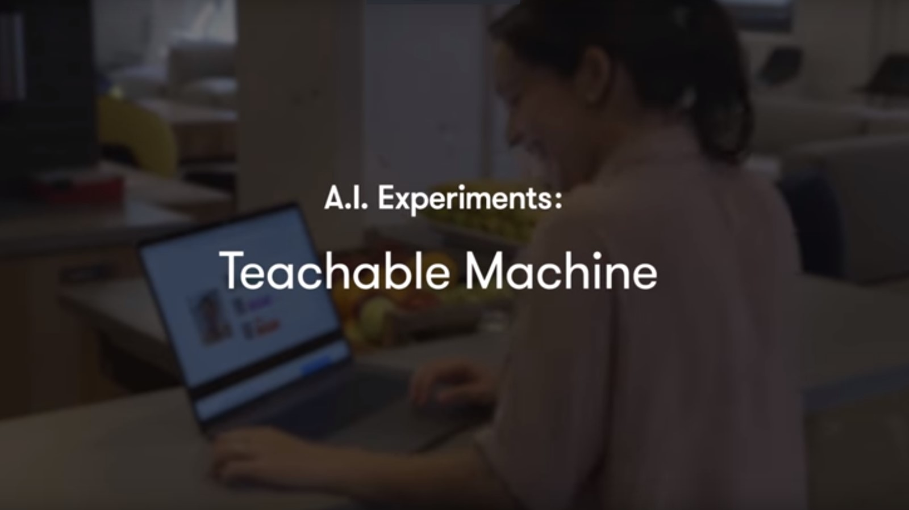

Slide 28
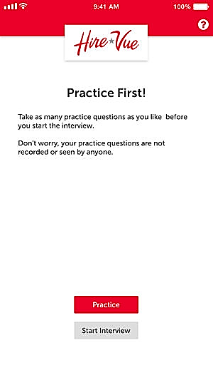
HireVue Overview
This will be a new experience for many applicants because top banks like Goldman Sachs and JP Morgan have recently begun to use HireVue. It apparently adds 13% more top performers above the client’s industry.
The first interview is provided by HireVue; however, it will not completely replace the more traditional, intensive recruiting process. If the first interview is successful, then a representative from the bank will contact the candidate for a second interview. From then on, any upcoming interviews will be part of the regular interview rounds, involving live interactions with analysts, associates and even VPs and MDs.
You will be given about 20-30 seconds for each question to think of a response. After that, you’ll have about 3 minutes to record your answer. The amount of time given really depends on the questions. For instance, a question about why you would be the best candidate for the role will require a much longer and thoughtful response than answering a question about what your overall GPA is.

Slide 30
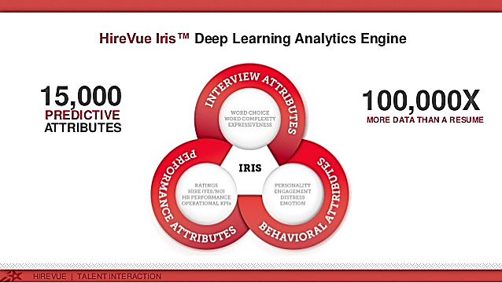
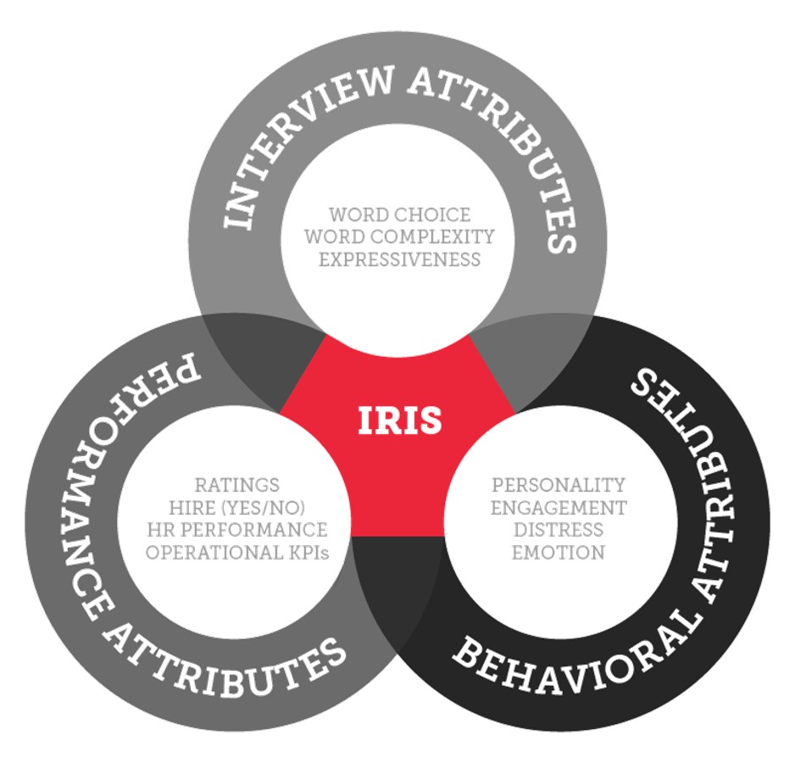

Slide 31
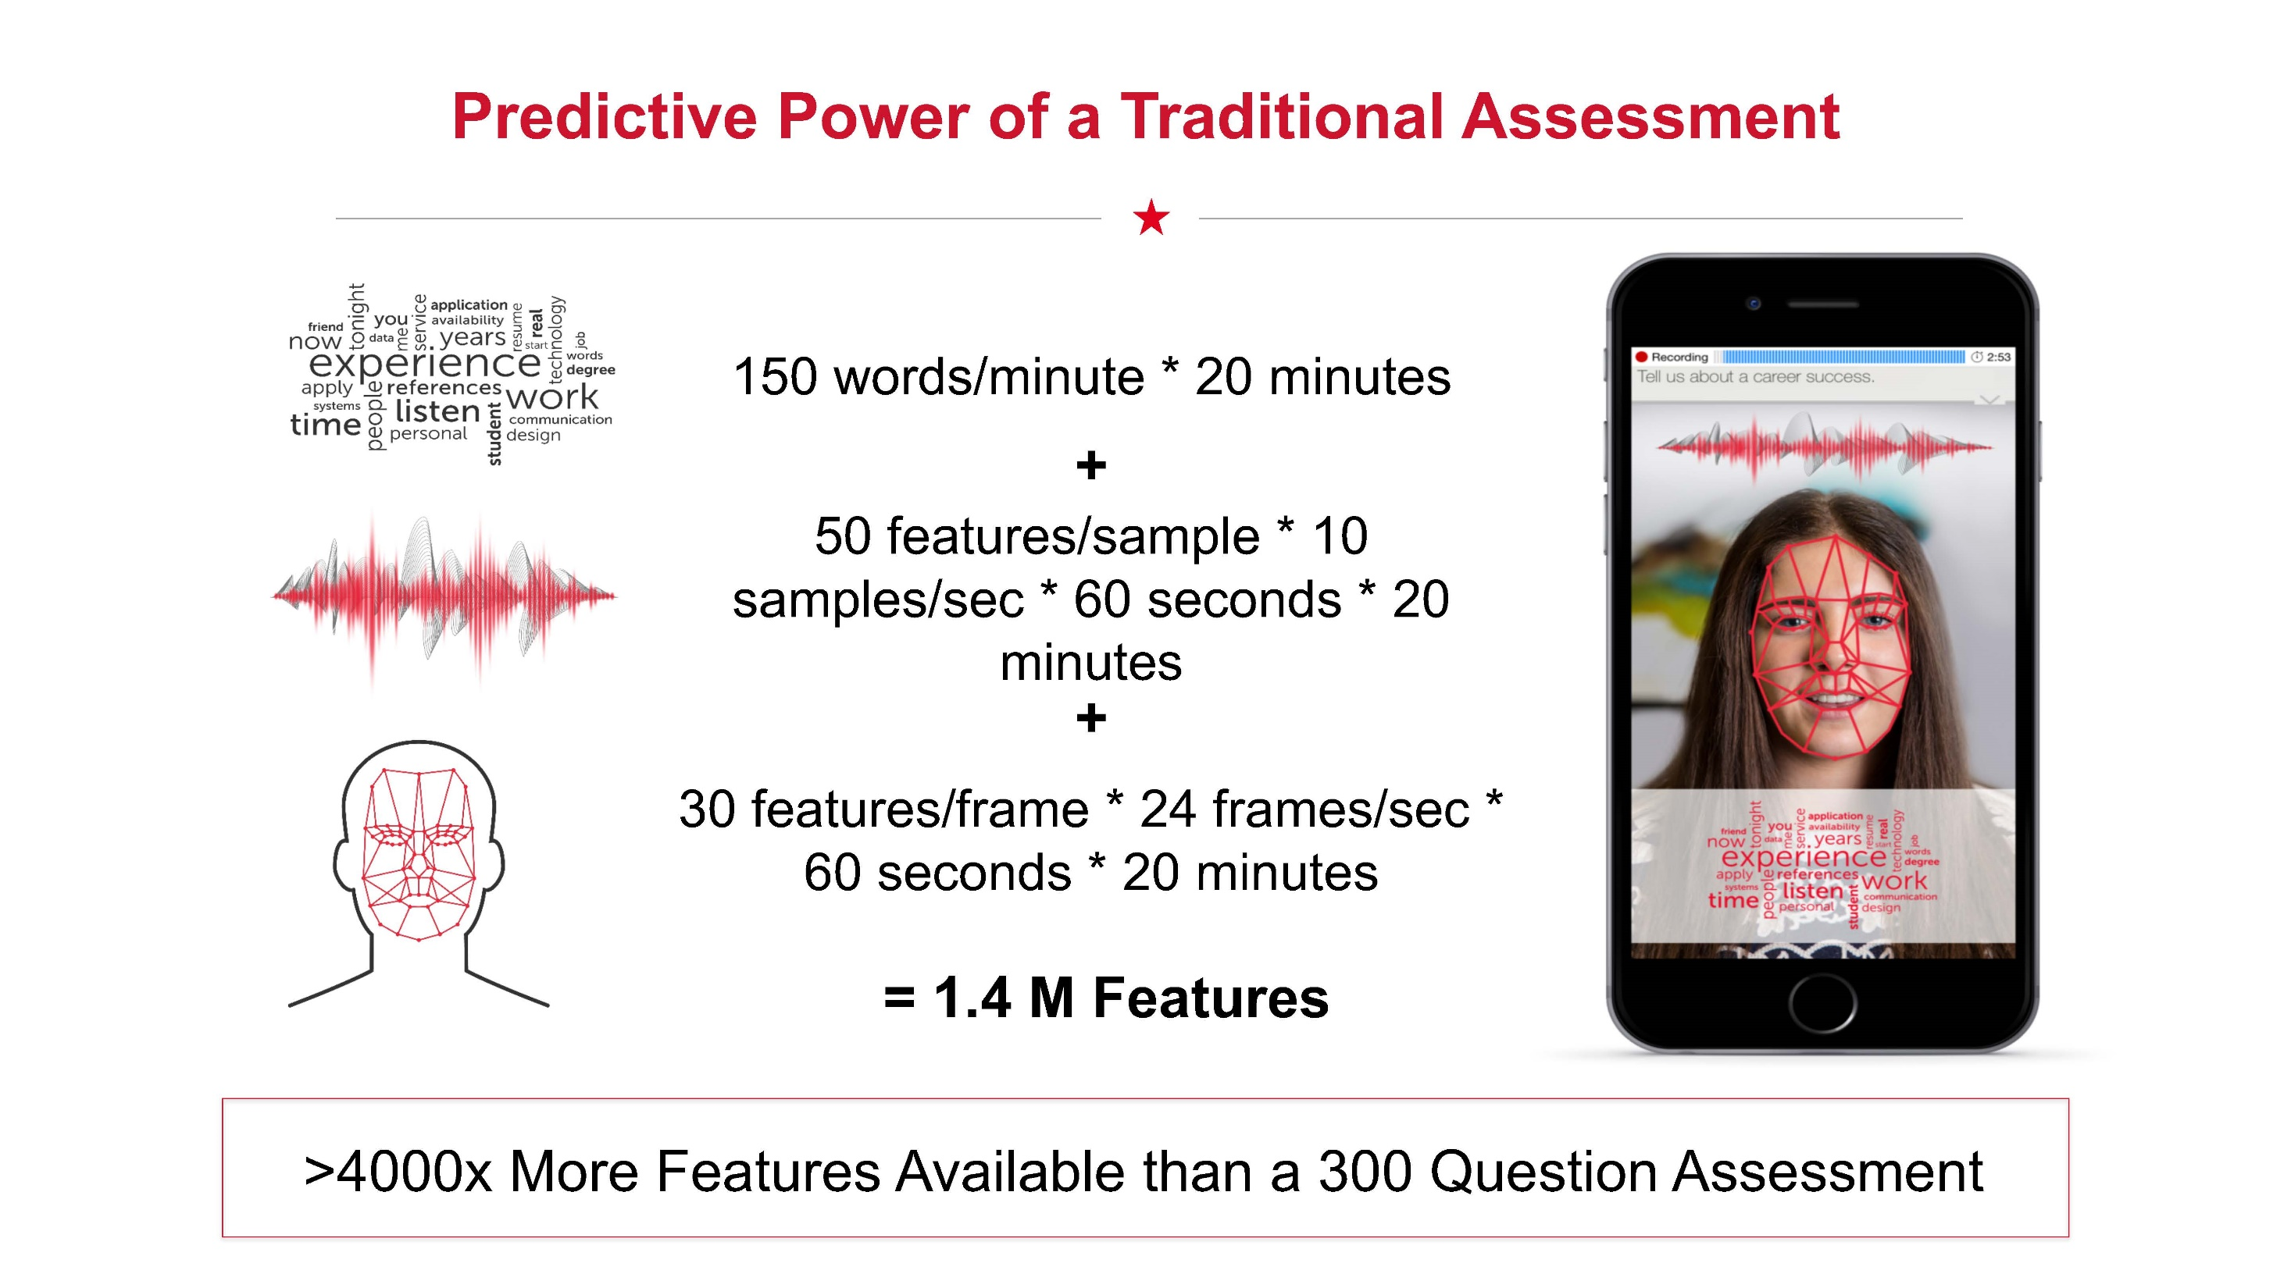

Slide 32
Underlying Mechanics
HireVue Iris, a patented deep learning analytics engine that powers HireVue Insights, analyzes a unique data set of interactions, feedback and outcomes that never before existed. Developed by HireVue's data science team, Iris was built based on over 3 million interview responses. Each candidate interview contains 100,000 times more bytes of data than the resume or profile traditionally used for identifying job candidates. The platform examines attributes in three major categories: interview attributes, behavioral attributes, and performance attributes. Iris’s proprietary algorithms discover patterns and learn which attributes predict performance, then scores each candidate on how they compare to existing top performers.
Video interview, the recruiter can see the personality, drive, and work ethic of a candidate. Furthermore, this attracts and captures more candidates from more schools, because the talent isn’t just found from target schools such as those belonging to Ivy League group.
HireVue Assessments evaluates tens of thousands of data points, studying both verbal and nonverbal content, including:
Word choice and vocabulary
Intonation
Inflection
Facial expressions

Slide 33
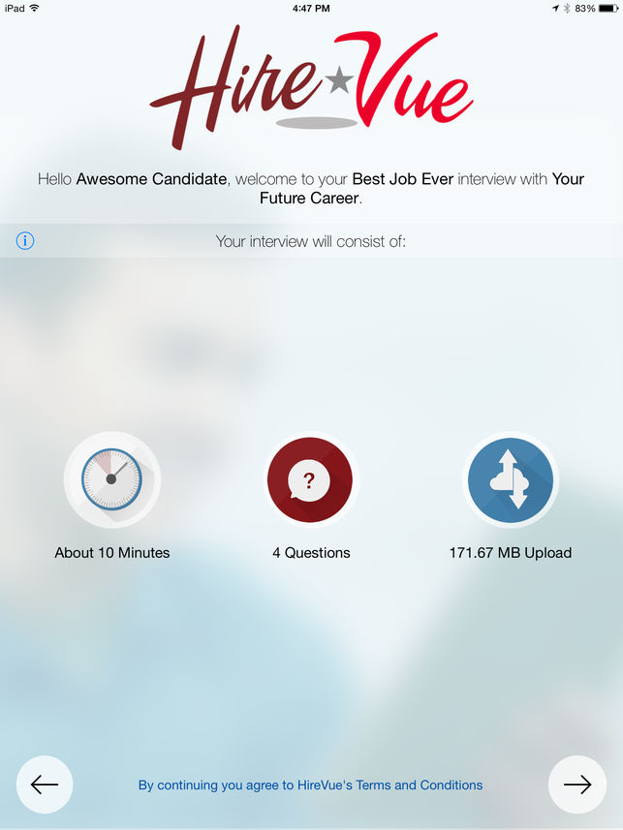
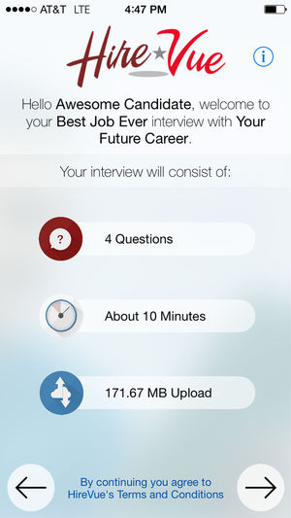

Slide 34
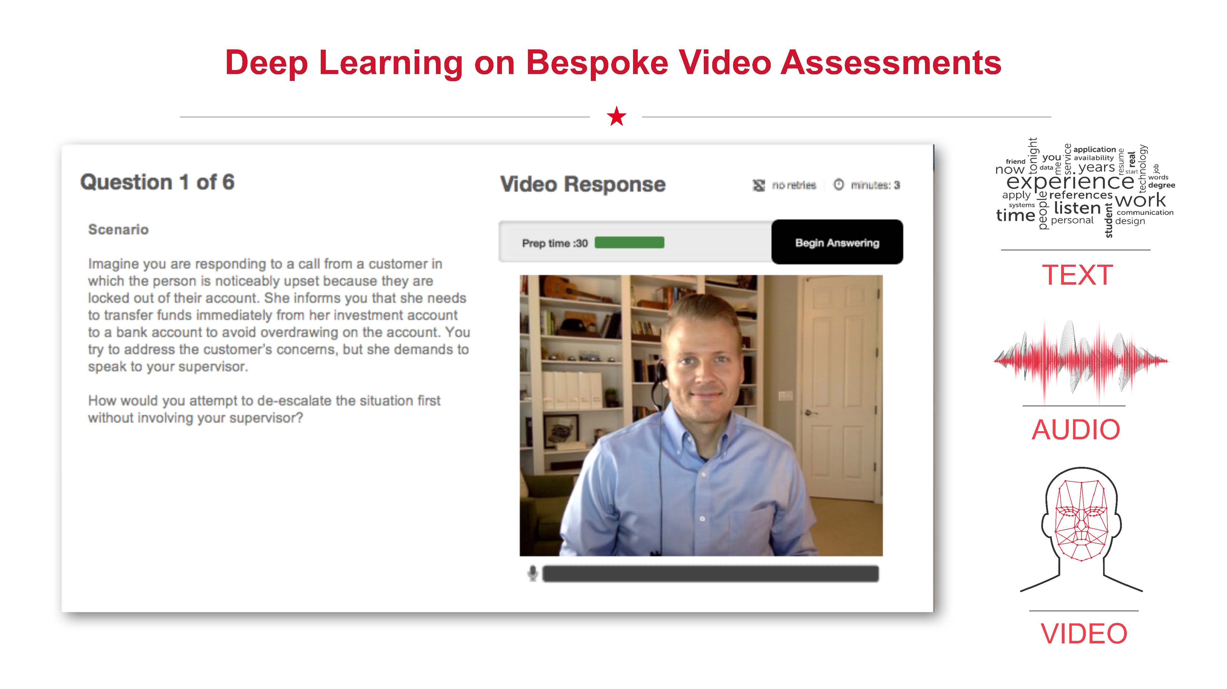

Slide 35
Sample Questions
Why are you applying for this position?
How did you deal with a difficult co-worker in your previous work experiences?
How did you handle a drastic change in role to achieve a goal?
Why do you think you are the right candidate for this position?
What current events are you following at the moment? Why are they interesting?
Do you have an expertise or unique experience that can benefit our team?
What is the most important leadership experience you have? And why?
What efforts do you make to keep abreast of financial markets and business news?
Why do you want to work for our company?
What relevant skills have you gained from your past work or internship that are easily transferable and directly beneficial to the new role you’re applying for?
Why are you looking for a new role in our company?
What were your top responsibilities at your current/previous position?
What are your three main weaknesses?
How will you use your background and skills to succeed in his role

Slide 36
Best Practices
Logistics
30 secs to prepare; 3 mins to answer; do not have to use all 3 mins; a minimum of 10 secs
Speak slowly with clear pronunciation and polished diction
Clean camera lens and keep camera at eye level
Notepad to minimize rambling
Resume and job description in front of you
Try not to prop up your phone
Phone fully charged and strong Wifi (350 Kbps per second)
Good background, clean desk and computer, bookshelf
Quiet locale (e.g. carpet and “things” to minimize echo)
Interview Preparation
Prepare questions in advance
Fully utilize sample interview before the real one
On-demand video interviews are always structured interviews, i.e. same questions, in the same order as everyone else for the position
Light
Near window for natural light
No light source from behind or below
Dress Code
Dress up (i.e. professional business attire)
Demeanor
Practice to avoid awkwardness and self-consciousness
Show enthusiasm and maintain eye contact, enthusiasm (i.e. no downcast)
Keep video feed near camera
Stand up and “present” if you can
Not evaluated based on stage presence
Examples
Toastmasters International, Enactus, TED

Slide 37
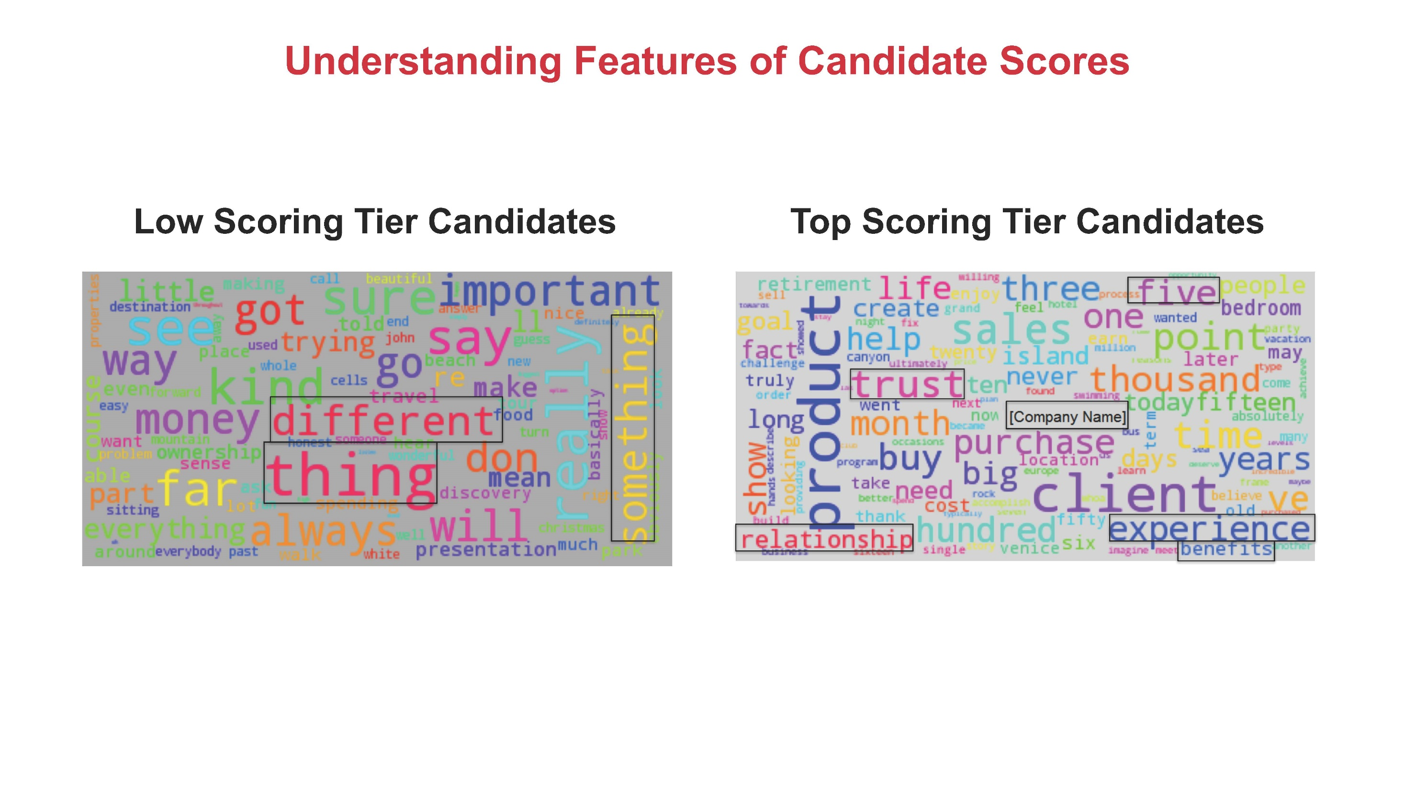

Slide 38
M
W
J
E
HU
HA
UC
MT
T
TF
CB

